Slide 1


I2C COMMUNICATION
Goal: Introduce the students to I2C communication with Arduino.

Slide 2
COMPONENTS:
Sparkfun Starter Kit
Adafruit BNO055 Absolute Orientation Sensor
Connecting probes
Software Required:
  Multisim

Slide 3
INTRODUCTION:
I2C is short for Inter-Integrated Circuit.
The circuit in which multiple chips can be connected to the same bus.
The I2C communication bus is very popular and broadly used by many electronic devices because it can be easily implemented in many electronic designs which require communication between a master and multiple slave devices.
The I2C Bus consists of two wires called the Serial Data (SDA) and the Serial Clock (SCL). Data is transmitted through the SDA line while the SCL line is used to synchronize the devices with the clock signal.

Slide 4
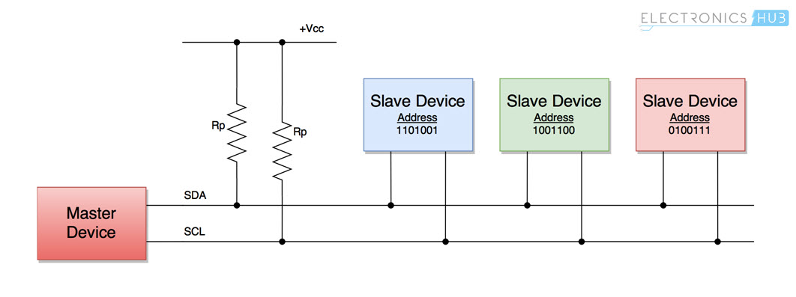
I2C BUS:
There are two types of devices that connect to the I2C Bus: Master and Slave.
Bus Masters are responsible for sending and receiving data to and from the slave devices. The clock signal is also supplied by the master.
I2C network supports multiple masters and multiple slaves (but we usually see single master and multiple slaves). Each slave device connected to the I2C bus has a unique 7-bit address.

Slide 5
ARDUINO:
ArduinO Uno is a microcontroller board based on the ATmega328P (datasheet).
It has 14 digital input/output pins (of which 6 can be used as PWM outputs), 6 analog inputs, a 16 MHz quartz crystal, a USB connection, a power jack, an ICSP header and a reset button.
It contains everything needed to support the microcontroller; simply connect it to a computer with a USB cable or power it with a AC-to-DC adapter or battery.
Arduino supports I2C Communication.

Slide 6
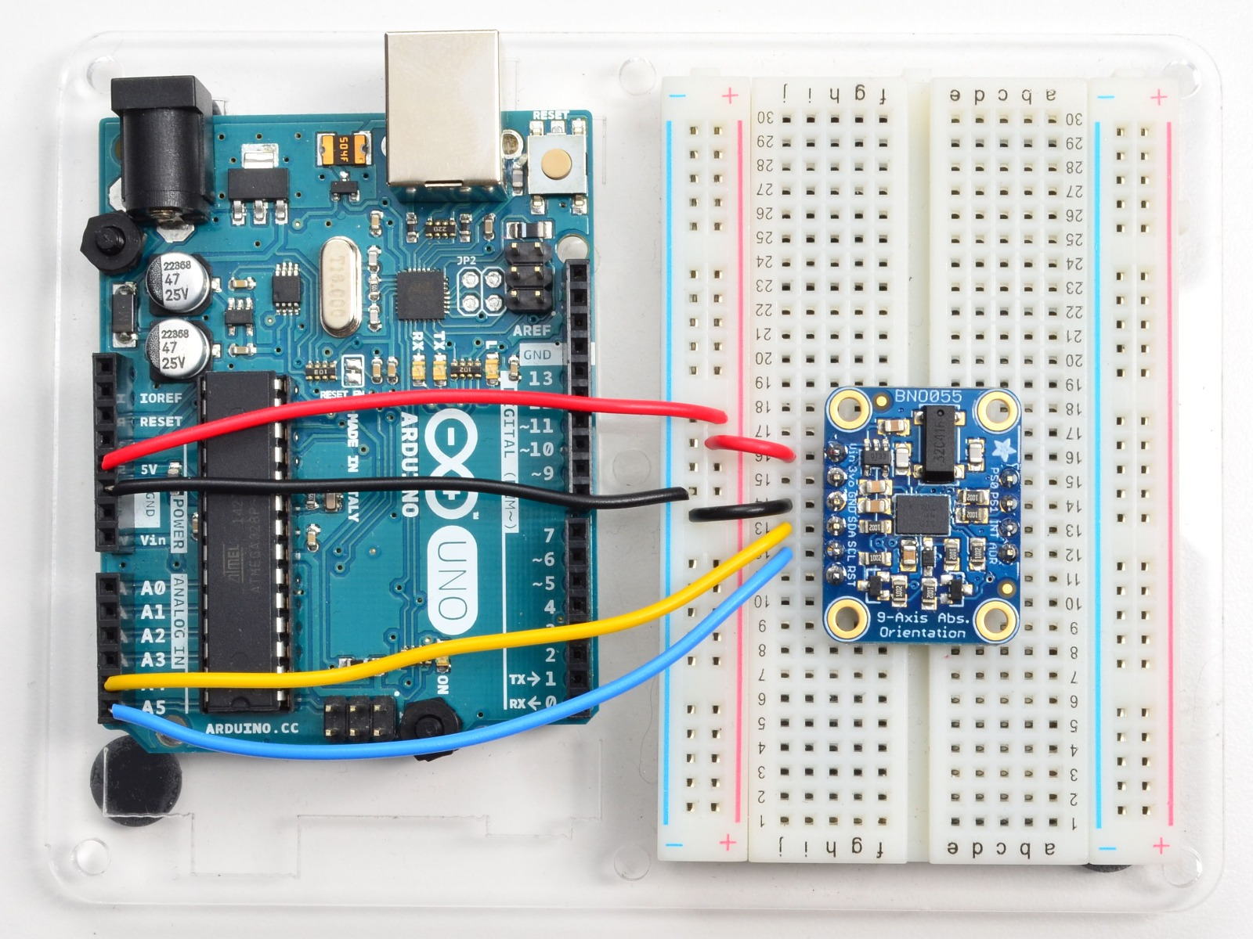
Circuit Diagram

